Slide 1


F
A
S
H
C
A
M
……a Reverse Image Search Engine

Slide 2
About FASHCAM
FashCam is an image search engine that uses computer vision to detect optical similar products for recommendation among an online shops inventory.
Customers can easily upload a picture of the desired item or take a live picture, select the piece of object with the help of crop feature so this engine can find exactly the same or similar fashion goods.

Slide 3
Benefits for e-commerce
FashCam visual search improves product discovery and the buying experience, leading to higher conversions and sales for eCommerce brands.
Customers can search for products based on images, leading to faster and more accurate purchase decisions.
The unique and simple search experience offered by FashCam drives product sales and increases revenue.

Slide 4
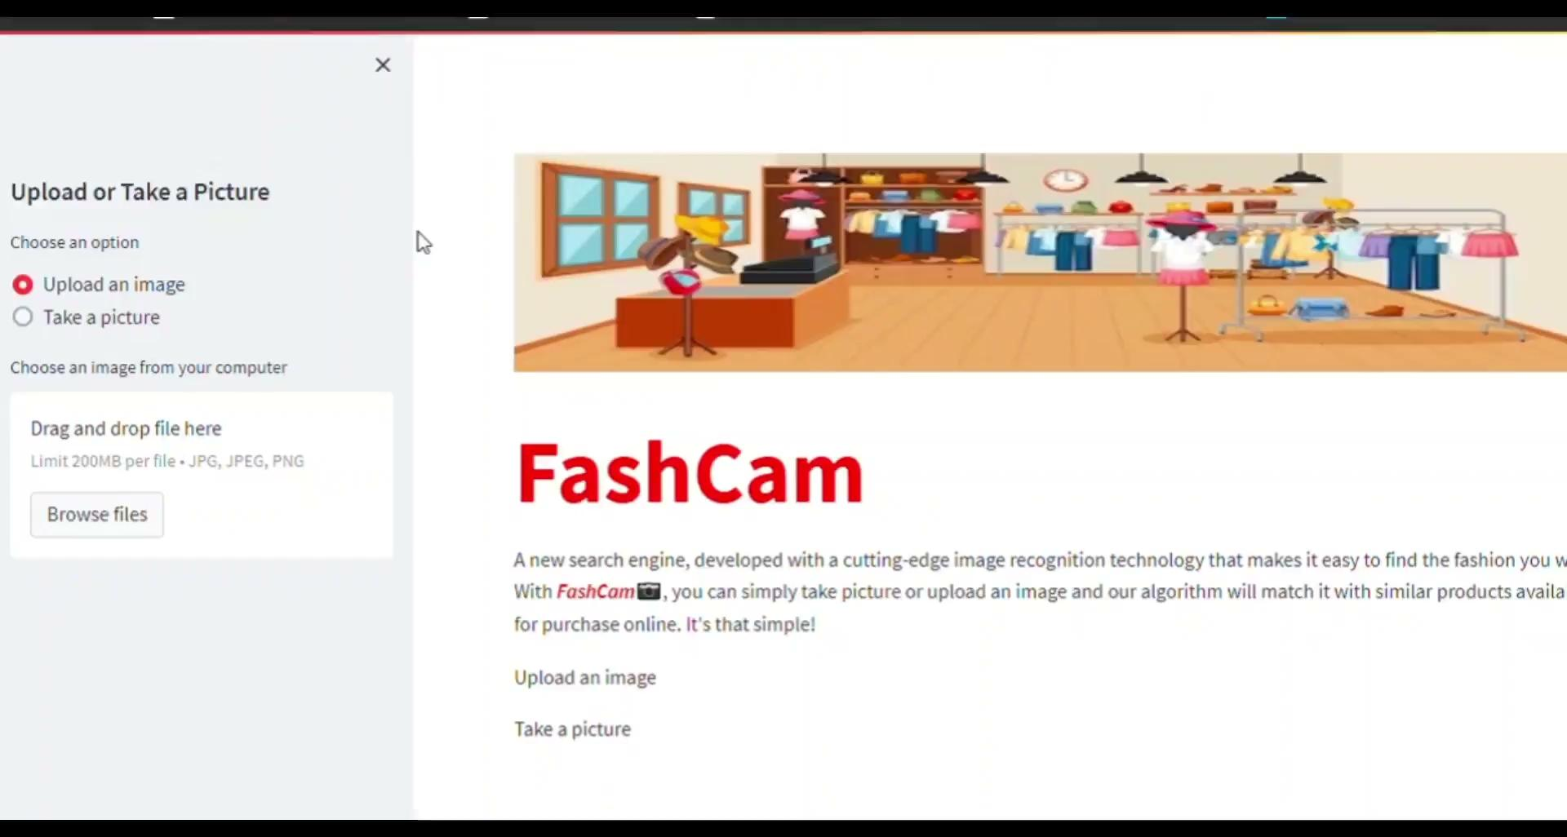
Demo : 1. Uploading an image of product

Slide 5
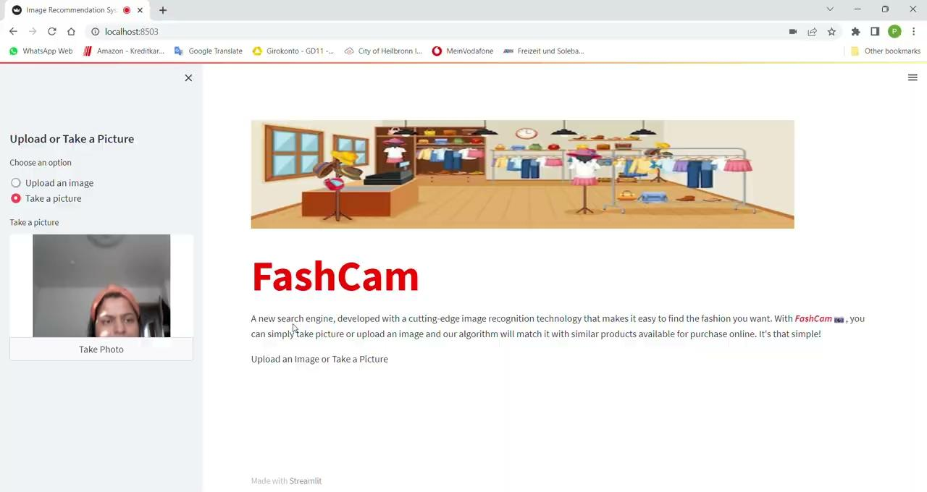
Demo : 2. Take a picture of product

Slide 6
Limitation & Improvement
It takes up to a couple of seconds to load the results.
Limited collection of recommended products.
It may misclassify noisy, unclear or blurry pictures.

